Slide 1
Model Deployment
Lungile Mawila

Slide 2
Introduction

Slide 3
Why Deploy ML Models in Web Apps?
1
Accessibility : Make Models available to users via browsers
2
Scalability: Serve multiple users simultaneously.
3
Real-Time Predictions: Enable instant decision-making.
4
Integration: Embed ML into business workflows.

Slide 4
Building a ML web app
02

Slide 5
Step 1: Preparing the model
Training the model
Saving the model state
This process includes using datasets to train your model, fined-tuned based on the results measured using metrics, (done on previous days)
Because you do not want to retrain your model every single time you reload the browser, save it’s current state (trained) on a disk in a .pkl or joblib format for example.

Slide 6
Step 2: Building an API (Backend)
Load Model
Create Endpoints
Return Predictions
Load your .pkl model into your API file(such as python file on a flask flamework)
Create endpoints such /predict that will accept input data
Create endpoints such /predict that will accept input data

Slide 7
Step 3: Build the UI (Frontend)
HTML/CSS/JS or any web framework
PowerBI/Tableau
HTML: Create buttons and forms to feed/get data into/from endpoints
CSS: Style your web app for a polished look and feel
JavaScript: Make your web app functional, including input validation and error messages
Not a way to deploy a model but a good way to communicate results and performance of it, in a professional manner
Interactive data visualizations for better storytelling
Real-time dashboards to track ML model performance
Design dashboards with KPI's (key performance metrics) to highlight model performance or business impact.

Slide 8
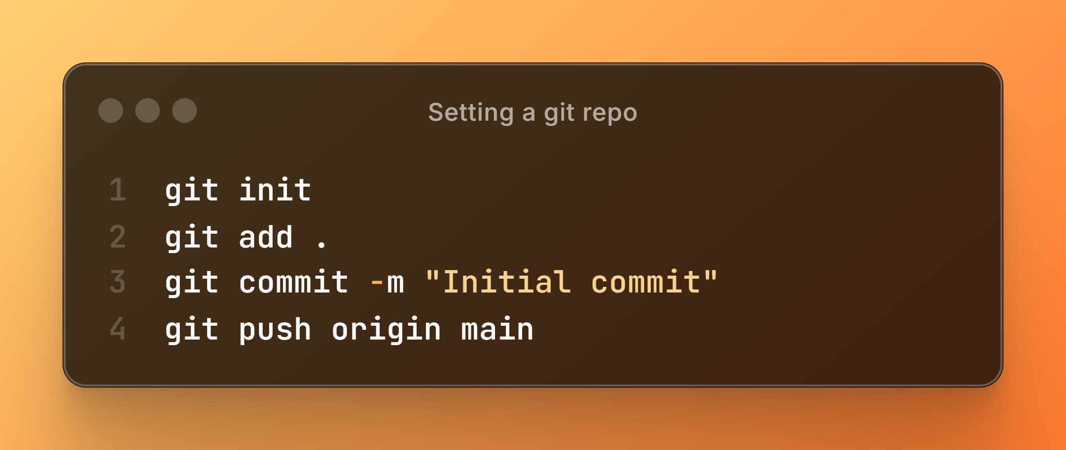
Step 4.1: Deployment
Git (Version Control)
Setting Up A Repository
Select a deployment platform that best suits your needs. Common options include:
GitHub / GitLab: Most deployment platforms require Git, so becoming familiar with it is essential.
Git for Version Control: Git helps track changes, manage collaboration, and streamline workflows. It also offers additional features for automation and security.
Understanding Git Repositories
A Git repository is a centralized storage location for your code, allowing version control, collaboration, and change tracking. It contains all project files, including branches and commit history.
Create a New Directory: Organize your project files.
Run git init: Initialize Git in the directory.
Add Files: Use git add . to stage your changes.
Commit Changes: Save the current state with git commit -m "Initial commit".
Connect to a Remote Repo: Link your local repository to GitHub/GitLab using git remote add origin <repo-URL>.
Push Changes: Upload your commits with git push origin main.

Slide 9
Step 5: Hosting
Choose a hosting Platform
Select a suitable deployment platform based on your needs. Possible options include:
PythonAnywhere: Cloud-based Python hosting.
Google Colab or Kaggle for Python Notebooks
Vercel: Great for front-end applications and serverless functions.
Other Platforms: Consider alternatives like AWS, Heroku, or Render, etc.

Slide 10
THANK YOU!

